Slide 1
Employee Performance Analysis Using Excel
PRESENTED BY: Bharath Kumar S
REGISTER NO.: 312204451
DEPARTMENT: COMMERCE
COLLEGE: K.C.S KASI NADAR COLLEGE OF ARTS AND SCIENCE

Slide 2
PROJECT TITLE
Employee Performance Analysis Using Excel

Slide 3
AGENDA
1.Problem Statement
2. Project Overview
3.End Users
4.Our Solution and Proposition
5. Dataset Description
6. Modelling Approach
7. Results and Discussion
8.Conclusion

Slide 4
PROBLEM STATEMENT
1.UNDERPERFORMANCE (Needs Improvement):
20% of the workforce needs improvement, which is a significant portion. These employees may be affecting team productivity and operational efficiency.
2.LACK OF DIVERSITY IN PERFORMANCE:
The data only shows two performance categories: "Fully Meets" and "Needs Improvement." There's no middle ground for employees” This limited range may not fully capture the nuances of employee performance
3.PERFORMANCE MANAGEMENT GAP:
The fact that 20% of employees fall into the "Needs Improvement" category could indicate gaps in performance management or training programs. Without regular feedback or development opportunities, employees may struggle to meet expectations.

Slide 5
PROJECT OVERVIEW
[EMPLOYEE PERFORMANCE IMPROVEMENT AND EVALUATION ENHANCEMENT]
Data Analysis
Performance Management System
Targeted Interventions for Improvement
Ongoing Monitoring and Support
Enhanced Performance Reporting
CHALLENGES AND RISKS
1.Employee Resistance
2.Time and Resources
3.Imbalance in Performance Recognition
EXPECTED OUTCOMES:
1.Improved Performance
2.Balanced Performance Evaluation
3.Increased Motivation and Engagement

Slide 6
WHO ARE THE END USERS?
Human Resources (HR) Department
Department Managers (Sales & Production)
Senior Leadership/Executives
Employees
Finance/Compensation Teams

Slide 7
OUR SOLUTION AND ITS VALUE PROPOSITION
Filtering - Remove missing values.
Conditional Formatting - Blanks, Background Color Shading, Data Bars, Values.
Data Filtering and Sorting - Identify specific employee groups, such as those with exceeds, needs improvements and fully meets.
Pivot table - Summary of employee performance under their current rating .
Graphs - FINAL REPORT.

Slide 8
DATASET DESCRIPTION
EMPLOYEE ID: Unique identifier for each employee in the organization.
FIRST NAME: The first name of the employee.
Performance Score: A score indicating the employee's performance level (e.g., Excellent, Satisfactory, Needs Improvement).

Slide 9
MODELLING
DATA SET: Kaggle, Employee dataset.
FEATURE SELECTION: Slicer, Conditional Formatting, Designing.
DATA CLEANING: Missing values, Irrelevant data, Correct Errors, Remove Unnecessary Columns and Rows.
PIVOT TABLE: Employee ID, First Name, Performance Score.
CHART: Report of Employee Performance based on their Employee Id is represent in Values and Performance Score presented as Column Chart.

Slide 10

RESULTS

Slide 11
CONCLUSION
The performance analysis highlights a clear need for improvement among 20% of the workforce who are rated as "Needs Improvement." To address this, the organization should implement targeted performance improvement plans, focusing on skill development, training, and managerial support. Additionally, the absence of any "Exceeds Expectations" category suggests that the current evaluation system lacks the granularity to differentiate and reward high performers.
By implementing a more detailed and structured performance evaluation system, the company can recognize top performers, motivate employees, and ensure that underperformers are given the necessary resources and guidance to improve. This approach will lead to a more productive, engaged, and balanced workforce, enhancing overall organizational success and reducing operational risks due to underperformance.

Slide 12
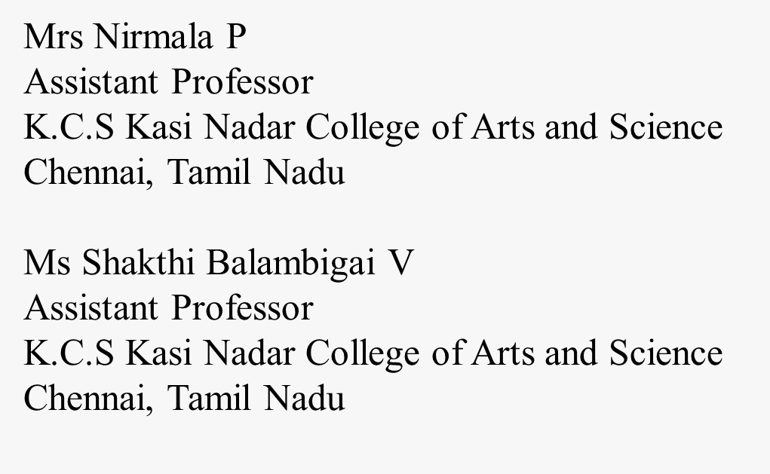
REFERENCE

